Slide 1
Smart Irrigation System
INTERNET OF THINGS ALGORITHMS AND SERVICES
Group:
Riccardo Gobbato
Pasquale Mocerino
Simone Scaccia
Project Github repository link

Slide 2
Problem
Waste of water in the context of irrigation systems:
Leaking water pipes
Unneeded water flows
Why do we need IoT
Leakages detection, quantification and localization
Automated water flow regulation
Water usage monitoring and management

Slide 3
Components
ESP32 MCU with LoRa support
Sensors: water flow and soil humidity
Actuators: solenoid valves
LoRa gateway
Cloud system (AWS)
Protocols
LoRaWAN
MQTT

Slide 4
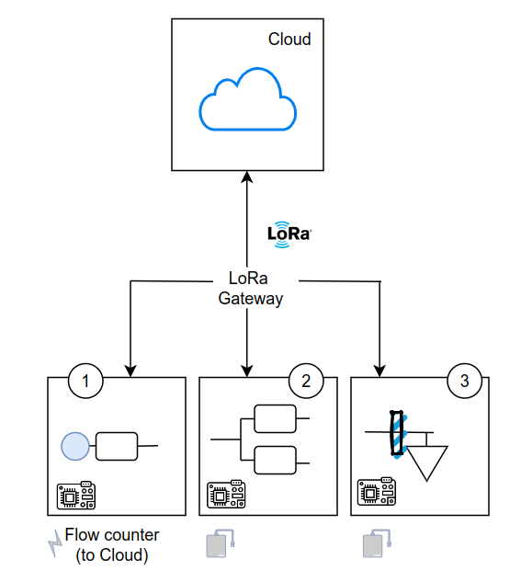
High-level
architecture

Slide 5
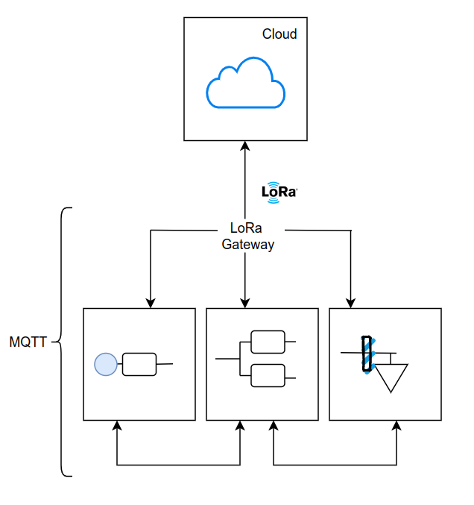
Network
architecture

Slide 6
Constraints
Bandwidth
The bandwidth of LoRa protocol is given by B = R_{s · 2}^{SF} .
We have to tune the symbol rate and the spreading factor in order to obtain a proper bandwidth for the communication between the MCUs. It depends on the distance between them in the network scheme.
Latency
For the moment, we suppose that there will not be strict constraints on latency: delays of some minutes are tolerated for the dynamic of our system

Slide 7
Constraints
Power consumption
Power supply of source site MCU is provided by a power cord, hence there are no specific constraints on power consumption
MCUs at fork sites, due to the limited workload, we wish to obtain a battery life equal to the total period of irrigation
For crop site MCUs we may obtain a battery life at least equal to the growing period of the related crop
Duty cycle
For soil humidity sensors, we wish to check the humidity every hour because climate can change approximately at this rate
For water flow sensors, we may check the status of the irrigation pipes one time per day in order to detect water leakages without tolerating more than one day of water losses

Slide 8
Evaluation
Network performance:
Latency (s)
Throughput (bit/s)
Algorithm performance:
Minimization of water utilization (l/s)
Minimization of response time of the overall system with respect to leakages (s)
Power consumption:
Energy consumption at fork site (mWh)
Energy consumption at branch site (mWh)

Slide 9
Thanks!
INTERNET OF THINGS ALGORITHMS AND SERVICES

